Slide 1

Proof of concept
Authentication System using face recognition
Business Unit: LEAP
Akshay Singh
10th July 2017

Slide 2
Acknowledgement

Slide 3
Present scenario
Manual effort
Time consuming
Error prone
Tedious entry search

Slide 4
“Who sees the human face correctly:
the photographer,
the mirror,
or the painter? “
-Pablo Picasso

Slide 5

Computer!

Slide 6









GreenScreen

Slide 7
Features
Portal
Data storage
Data access
Face recognition

Slide 8
Face recognition
Detect faces
Train data
Classify person

Slide 9

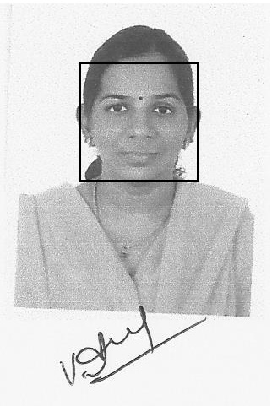


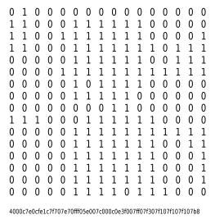
Creating the data set
‘a999999_1’
‘a999999’
‘999999’
ID

Slide 10



Training the classifier
#1
#2
#3
Eigen
Fisher
LPBH
Training
data
ID

Slide 11







Recognizing
‘a999999’
database
999999
prediction
preprocessing
Training
data

Slide 12
Challenges and constraints
Low quantity of data
Low quality of data
Light and orientation sensitive
Allows still images of people as well

Slide 13
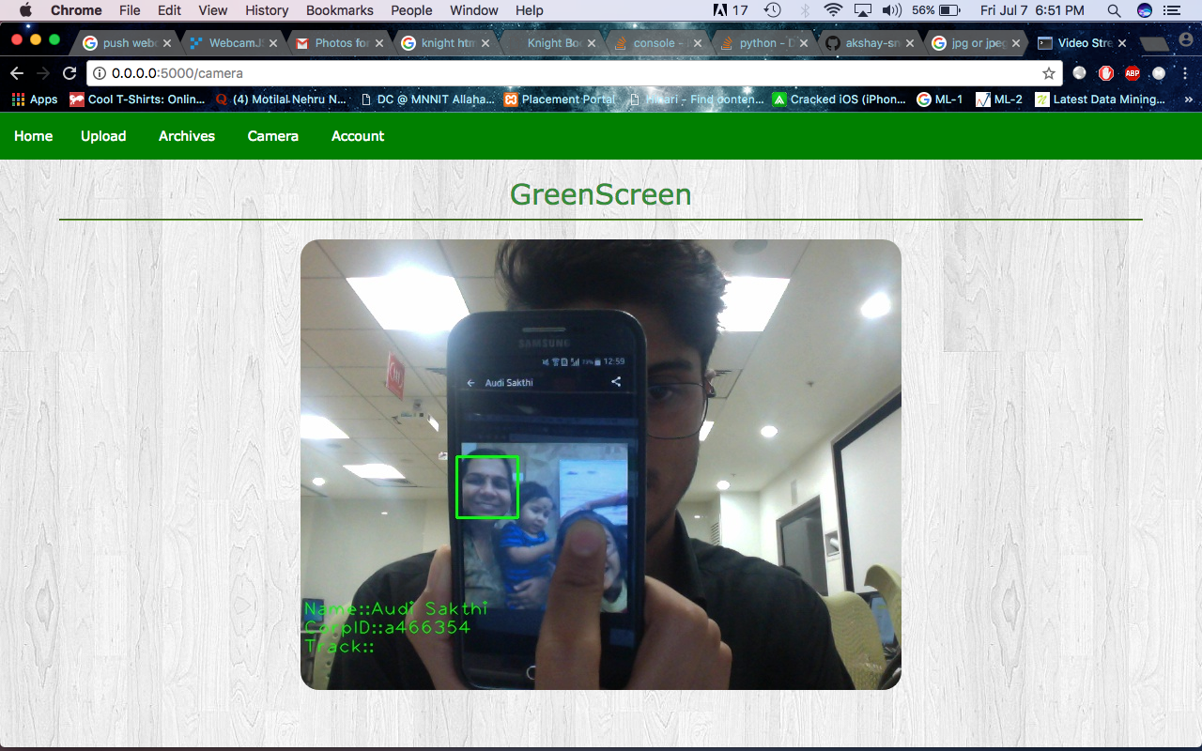
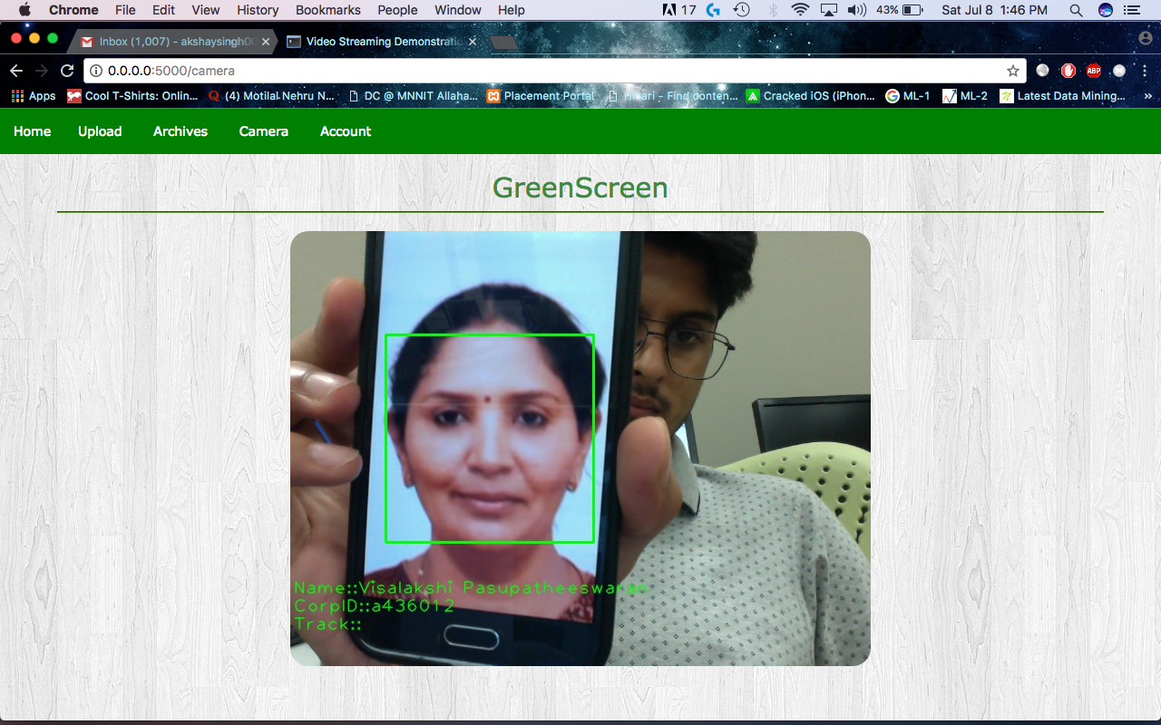
Testing with still images

Slide 14
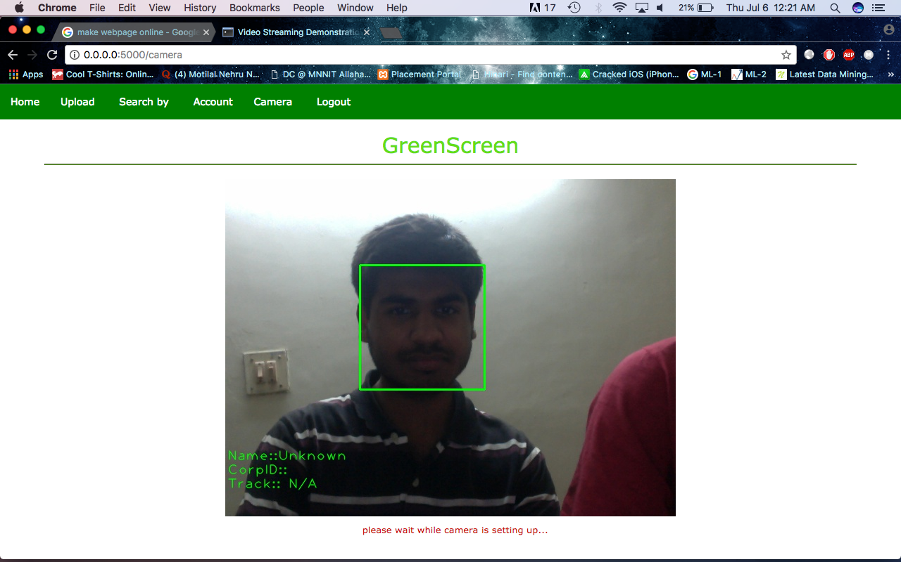
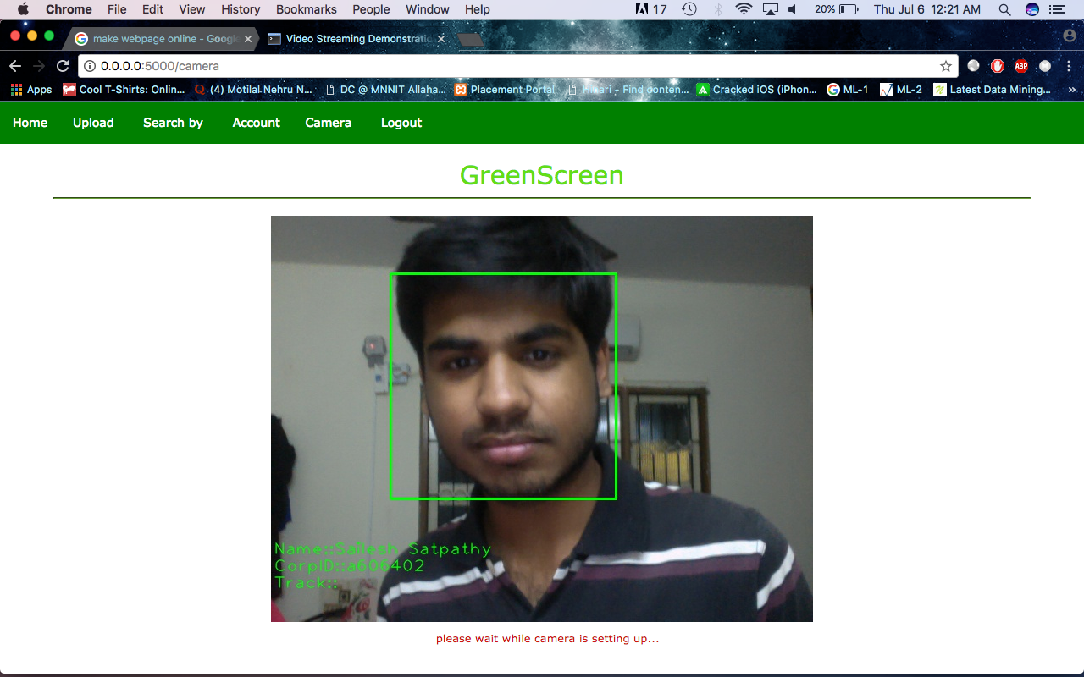
Light Test
Anti light
Facing the light

Slide 15








Attendance management
Student
Instructor
Track
Class
Information

Slide 16



Implementation

Slide 17
Thank you

